Slide 1
Service Mesh & Security
For Kubernetes
version 0.8.3

Slide 2
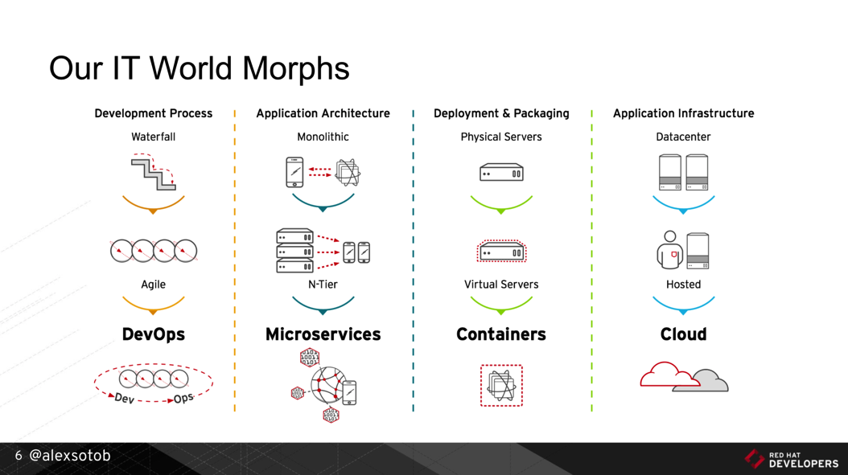
1. Digital Transformation: IT World is changing
https://www.slideshare.net/asotobu/sail-in-the-cloud

Slide 3
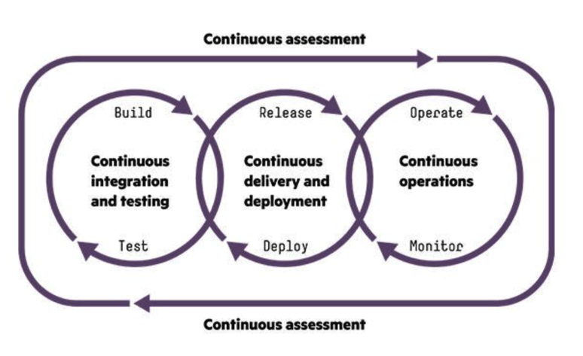
1. Digital Transformation: CI/CD, DevOps, Jenkins,..
https://www.slideshare.net/asotobu/sail-in-the-cloud

Slide 4
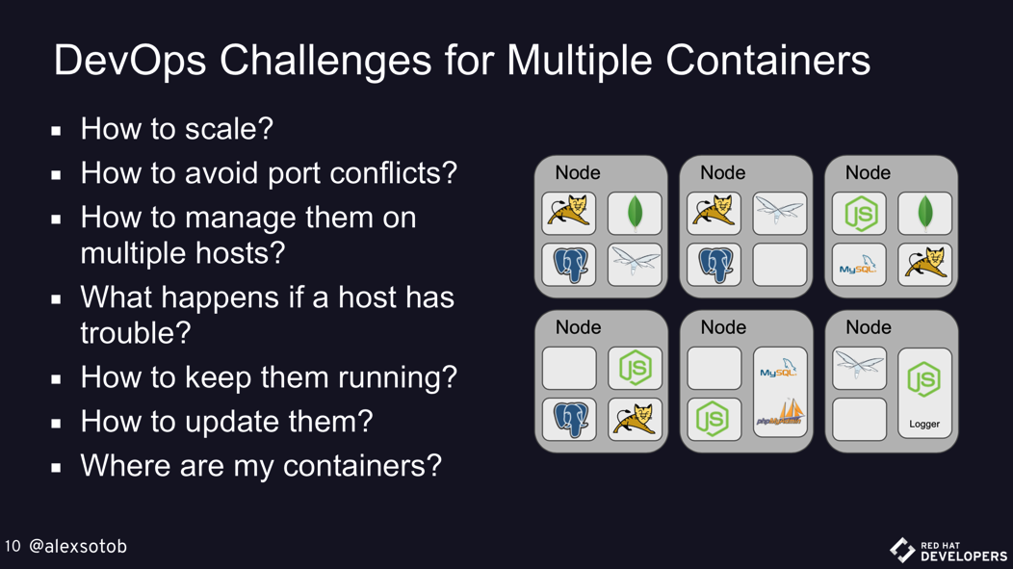
1. Digital Transformation: New challenges
https://www.slideshare.net/asotobu/sail-in-the-cloud

Slide 5
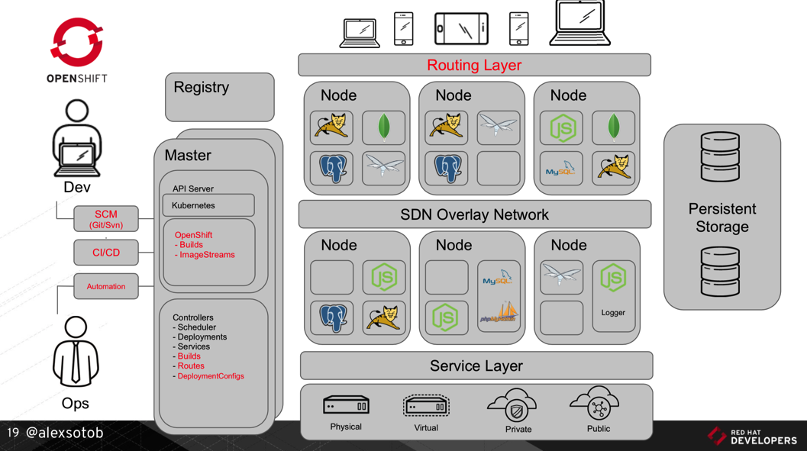
1. Digital Transformation: A new Platform
https://www.slideshare.net/asotobu/sail-in-the-cloud

Slide 6
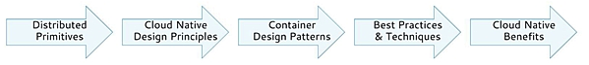
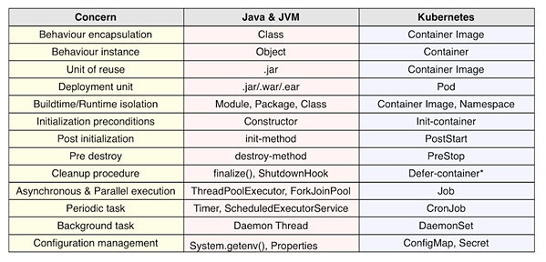
2. Kubernetes effect on the SDLC: Primitives (1/2)
1
https://www.infoq.com/articles/kubernetes-effect

Slide 7
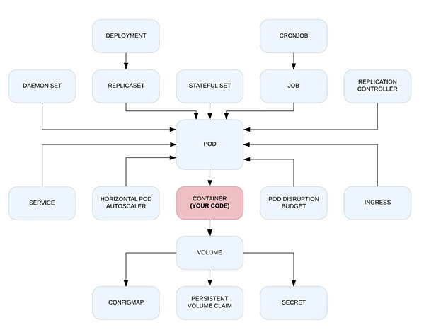
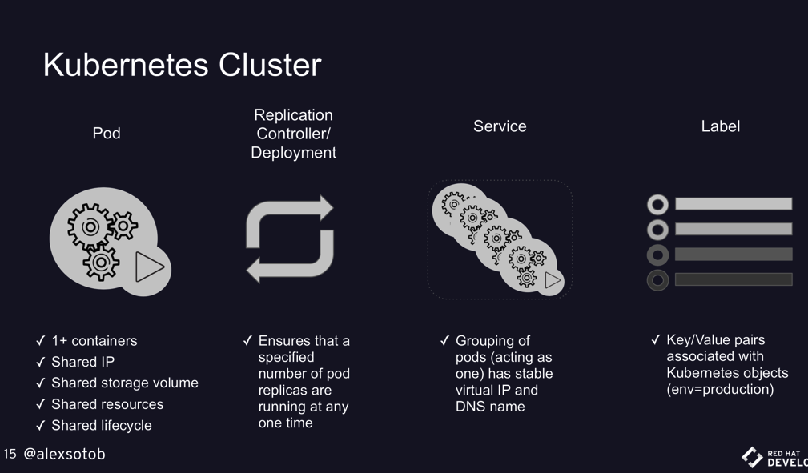
2. Kubernetes effect on the SDLC: Primitives (2/2)
1
https://www.infoq.com/articles/kubernetes-effect
https://www.slideshare.net/asotobu/sail-in-the-cloud

Slide 8
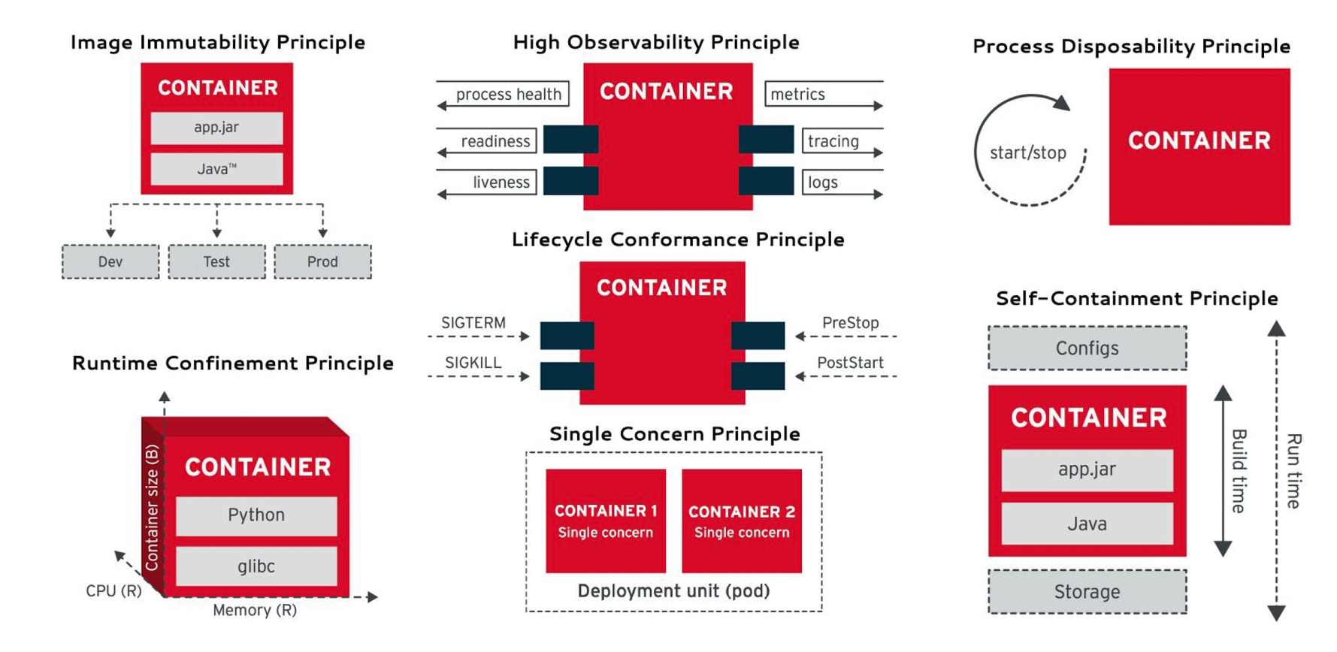
2. Kubernetes effect on the SDLC: Principles
2
https://www.infoq.com/articles/kubernetes-effect

Slide 9
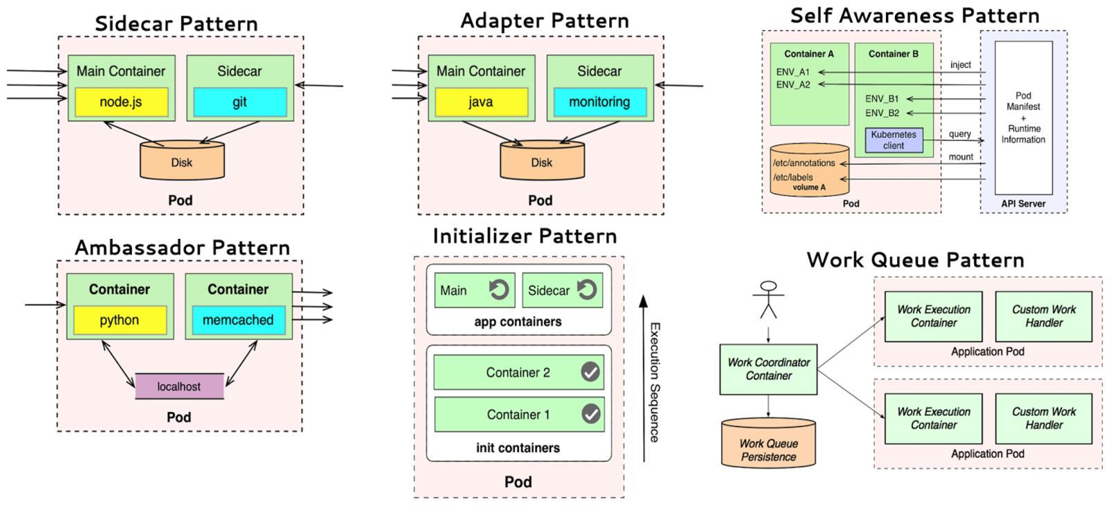
2. Kubernetes effect on the SDLC: Patterns
3
https://www.infoq.com/articles/kubernetes-effect

Slide 10
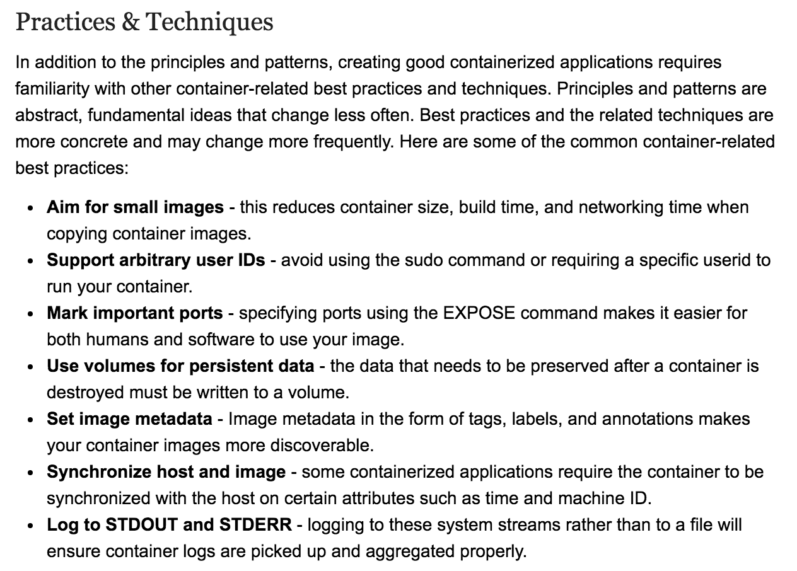
2. Kubernetes effect on the SDLC: Best Practices
4
https://www.infoq.com/articles/kubernetes-effect

Slide 11
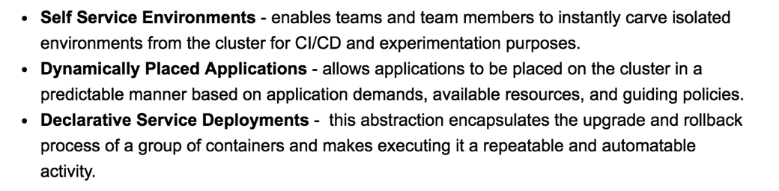
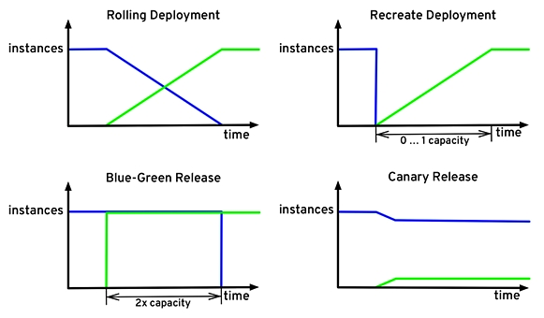
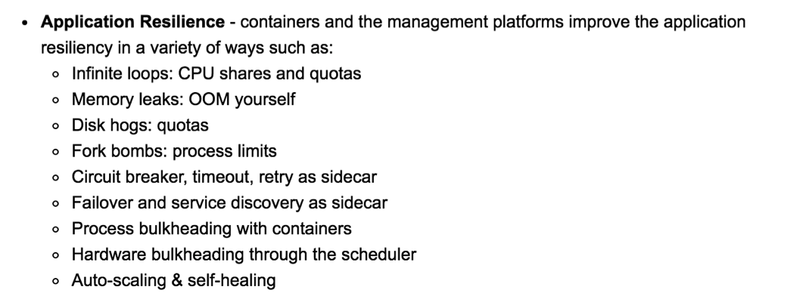
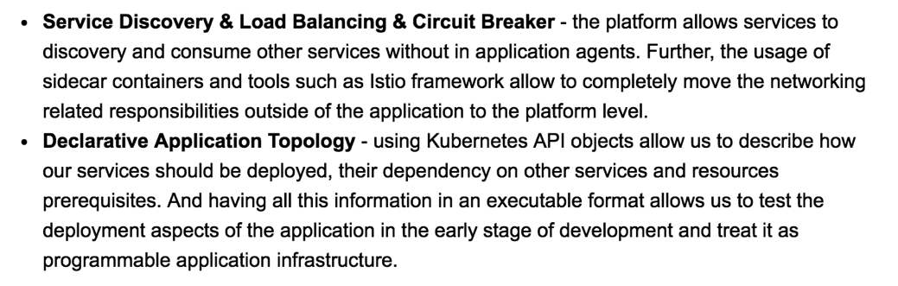
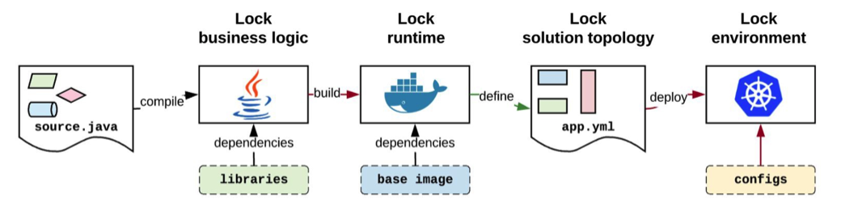
2. Kubernetes effect on the SDLC: Benefits
5
https://www.infoq.com/articles/kubernetes-effect

Slide 12

3. Lab 00: Building K8s - choose yours (1/2)
Vanilla
Kubernetes Clients
Kubernetes flavours
Self Managed
Full Managed Cloud
kubectl
(kubernetes)
Kubernetes Cluster
On-premise
Google Kubernetes Engine
KVM
VMWare
oc (openshift)
RedHat OpenShift v3
Azure Container Service (AKS)
Amazon EC2
az
(azure)
RedHat OpenShift Container Platform
Minimalist
Minikube
OpenShift
Minishift
Amazon Fargate
Amazon EKS
Amazon ECS
Managed

Slide 13
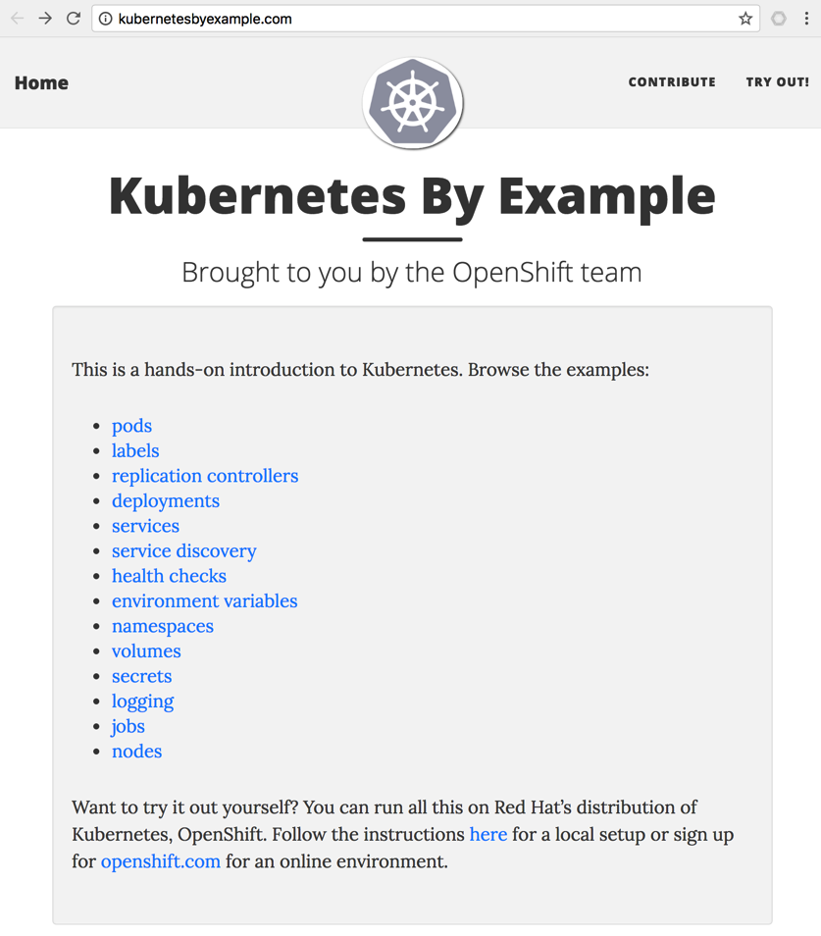
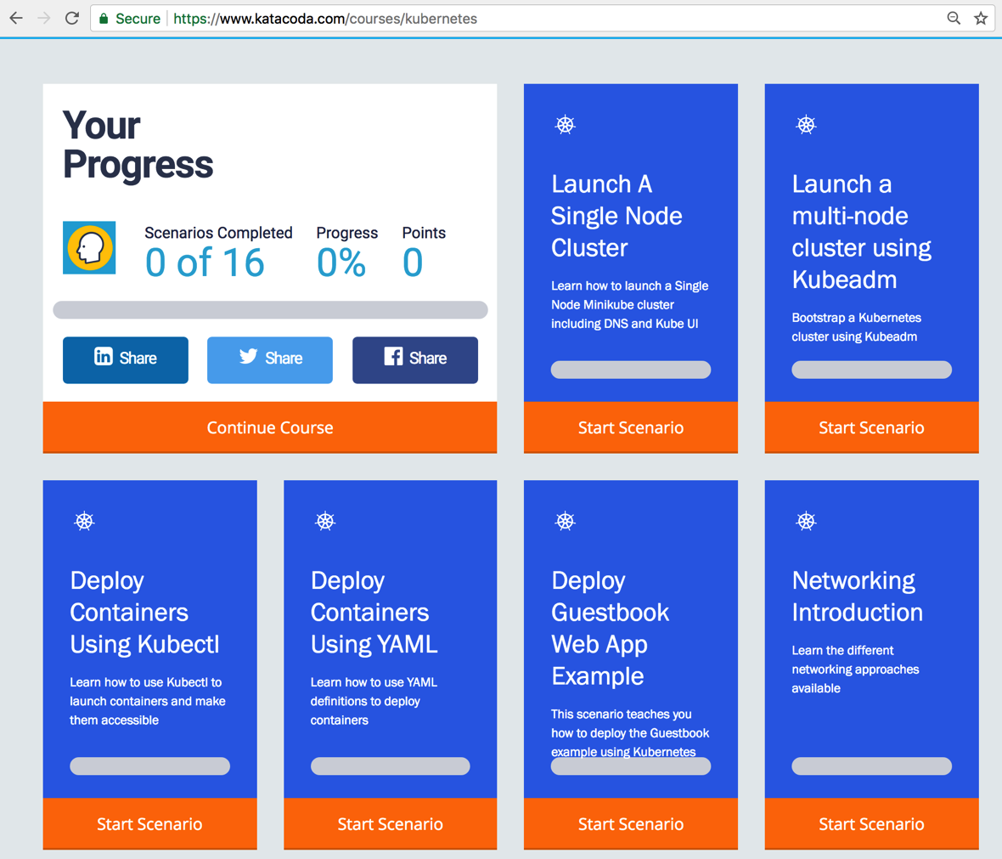
3. Lab 00: Building K8s - acquire practice (2/2)
1
http://kubernetesbyexample.com
https://www.katacoda.com/courses/kubernetes

Slide 14

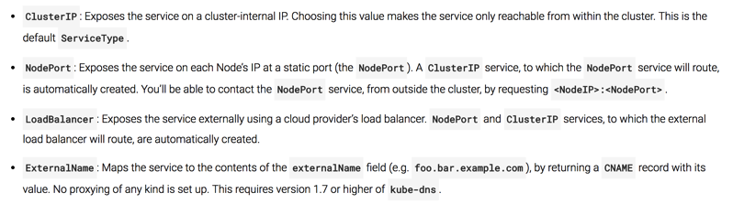
3. Lab 01: Delivering Apps (Pods & Services) 1/2
Hosting (Amazon EC2, Google Kubernetes, Minikube, etc.)
Kubernetes / Node₁
Edge Proxy
(Load Balancer)
Too difficult to add more routes.
Namespace_{A}
Port₁
LoadBalancer
Namespace_{A}
Namespace_{B}
nodePort₁
(hello-svc-lb)
Pod₁
http://<PublicIP>:<PublicPort>/hello
Pod₃
Docker₁
Docker Registry
DNS
Port₂
NodePort
nodePort₂
(hello-svc-np)
5000
(hello-v1)
Port₃
ClusterIP
Pod₂
Node₂
(hello-svc-cip)
Namespace_{C}
Docker₂
Pod₄
Any container can hit to other container running in different namespaces.
Too difficult to add security (MTLS, ACL, ..)
2
5000
(hello-v2)
1
http://<clusterIP>:<nodePort>/hello
Docker₄
Services
Deployment
http://<NodeIP>:<nodePort>/hello
http://<ServiceName>.<NameSpace>.svc.cluster.local:<port>/hello
External Network
spec.loadBalancerIp:spec.pops[*].port
Internal Network (Backend)
<NodeIP>:spec.ports[*].nodePort
spec.clusterIp:spec.ports[*].port

Slide 15
3. Lab 01: Delivering Apps (Pods & Services) 2/2
Hosting (Amazon EC2, Google Kubernetes, Minikube, etc.)
Kubernetes / Node₁
Edge Proxy
(Load Balancer)
Too difficult to add more routes.
Namespace_{A}
Port₁
LoadBalancer
Namespace_{A}
Namespace_{B}
nodePort₁
(hello-svc-lb)
Pod₁
http://<PublicIP>:<PublicPort>/hello
Pod₃
Docker₁
Docker Registry
DNS
Port₂
NodePort
nodePort₂
(hello-svc-np)
5000
(hello-v1)
Port₃
ClusterIP
Pod₂
Node₂
(hello-svc-cip)
Namespace_{C}
Docker₂
Pod₄
Any container can hit to other container running in different namespaces.
Too difficult to add security (MTLS, ACL, ..)
2
5000
(hello-v2)
1
http://<clusterIP>:<nodePort>/hello
Docker₄
Services
Deployment
http://<NodeIP>:<nodePort>/hello
http://<ServiceName>.<NameSpace>.svc.cluster.local:<port>/hello
## creating the namespace and service account
$ kubectl apply –f hello-ns-sa.yaml
## scheduling the pods to host the application
$ kubectl apply –f hello-deployment.yaml
## exposing the application as k8s services
$ kubectl apply –f hello-services.yaml
## scheduling all together
$ kubectl apply –f hello-app.yaml
## introducing a ‘malicious’ container
$ kubectl run malicious-curl --image=radial/busyboxplus:curl -it -n malicious --replicas=1
[ root@malicious-curl-6b6f76f5f9-bsl9x:/ ]$ nmap xyz
## gathering information about the services living in kubernetes
[ root@malic...:/ ]$ nslookup hello-svc-np.hello.svc.cluster.local
## calling an API from other namespace
[ root@malic...:/ ]$ curl -sv hello-svc-np.hello.svc.cluster.local:5030/hello
## DoS
[ root@malic...:/ ]$ export HELLO_URL=hello-svc-np.hello.svc.cluster.local:5030
[ root@malic...:/ ]$ while true; do curl -s -o /dev/null http://$HELLO_URL/hello; done
## getting all system environment variables available in a POD
$ kubectl exec hello-v1-69c9685b5-97vqs -n hello -- printenv

Slide 16
3. Lab 02: Ingress & Traffic Management (1/3)
Hosting (Amazon EC2, Google Kubernetes, Minikube, etc.)
Kubernetes
Node₁
Ingress Controller
Namespace_{A}
Edge Proxy
(Load Balancer)
Ingress Resource₁
Namespace_{A}
LoadBalancer
....
Port₁
LoadBalancer
Namespace_{A}
Ingress Resource_{n}
nodePort₁
(hello-svc-lb)
Pod₁
http://<PublicIP>:<PublicPort>/hello
Docker₁
Docker Registry
Port₂
NodePort
1
nodePort₂
(hello-svc-np)
5000
(hello-v1)
Deployment
2
3
Port₃
ClusterIP
Pod₂
Service
Ingress
(hello-svc-cip)
Docker₂
Call NodePort or ClusterIP to Pods
5000
(hello-v2)
What Ingress Controller can use?
An Ingress Controller is a Proxy that works as Kubernetes Controller. They manage the traffic between EdgeProxy and Service Mesh (APIs/Microservices).
A Proxy deployed in Pods doesn’t mean that you have an Ingress Controller.
There are several Ingress Controller implementations, they can manage different kind of traffic (HTTP, HTTPS, gRCP, Websockets, TCP, UDP, …) and different functionalities (VIP, Virtual Hosts, Paths, …); then the chosen Ingress Controller depends on the kind of traffic that your API/Microservices manage and how they were implemented (Ports exposed, Paths used, Headers expected, etc.)
Examples:
Heption Contour (based on Envoy Proxy)
Istio Ingress Controller (based on Envoy Proxy)
Linkerd Ingress Controller (based on Linkerd Gateway)
HAProxy Controller (based on HAProxy)
NGINX Controller (based on NGINX)
Etc.
1
Deploy the choosen Ingress Controller in Pods and in a specified Namespace.
Configure and integrate the deployed Ingress Controller with the EdgeProxy (Firewall, Root Proxy, Load Balancer, etc.). Generally, Ingress Controller is configured as Kubernetes Service LoadBalancer.
2
3
Finally, during CD time, every API/Microservice will be deployed with Ingress Resource definition (routing)

Slide 17
3. Lab 02: Ingress & Traffic Management (2/3)
Hosting (Amazon EC2, Google Kubernetes, Minikube, etc.)
Kubernetes
Node₁
Ingress Controller
Namespace_{A}
Edge Proxy
(Load Balancer)
Ingress Resource₁
Namespace_{A}
LoadBalancer
....
Port₁
LoadBalancer
Namespace_{A}
Ingress Resource_{n}
nodePort₁
(hello-svc-lb)
Pod₁
http://<PublicIP>:<PublicPort>/hello
Docker₁
Docker Registry
Port₂
NodePort
1
nodePort₂
(hello-svc-np)
5000
(hello-v1)
Deployment
2
3
Port₃
ClusterIP
Pod₂
Service
Ingress
(hello-svc-cip)
Docker₂
Call NodePort or ClusterIP to Pods
5000
(hello-v2)
I’ve implemented the Ingress Controller in Service Mesh.
Now, Is that Secure?
Not, It isn’t because that doesn’t have:
Separation of Duties
Identity-based Security
End-to-end security: the App Container still is available and nobody can stop to make call to that Container.
Container Patterns (sidecar container as last-mile protention)

Slide 18
3. Lab 02: Ingress & Traffic Management (3/3)
Hosting (Amazon EC2, Google Kubernetes, Minikube, etc.)
Kubernetes
Node₁
Namespace_{secure}
Namespace_{A}
Edge Proxy
(Load Balancer)
Ingress Controller
Ingress Resource₁
Namespace_{A}
LoadBalancer
....
Port₁
LoadBalancer
Namespace_{A}
Ingress Resource_{n}
nodePort₁
(hello-svc-lb)
Pod₁
http://<PublicIP>:<PublicPort>/hello
Docker₁
Docker Registry
Port₂
NodePort
Sidecar_{x}
1
nodePort₂
(hello-svc-np)
5000
(hello-v1)
Deployment
2
3
Port₃
ClusterIP
Pod₂
Service
Ingress
(hello-svc-cip)
Docker₂
AuthN & AuthZ
Service
Sidecar_{y}
Call NodePort or ClusterIP to Pods
5000
(hello-v2)
5
“Identity-based Security” strategy
4
Container Patterns
1
Deploy the choosen Ingress Controller in Pods and in a specified Namespace.
Inject Sidecar Container in the same Pod where the App Container is living. This sidecar bootstrap security configuration in order to reject traffic comming from untrusted source (other App Containers)
Configure and integrate the deployed Ingress Controller with the EdgeProxy (Firewall, Root Proxy, Load Balancer, etc.). Generally, Ingress Controller is configured as Kubernetes Service LoadBalancer.
4
2
+
5
In this Service Mesh the “Single Source of Truth“ is the “AuthN & AuthZ Service”. It validates and authorize all traffic that the App Container will process.
3
Finally, during CD time, every API/Microservice will be deployed with Ingress Resource definition (routing)
To implement this, follow this guide:
https://github.com/kelseyhightower/istio-ingress-tutorial

Slide 19
3. Lab 03: Weaving Service Mesh – Ref. Arch.

Slide 20
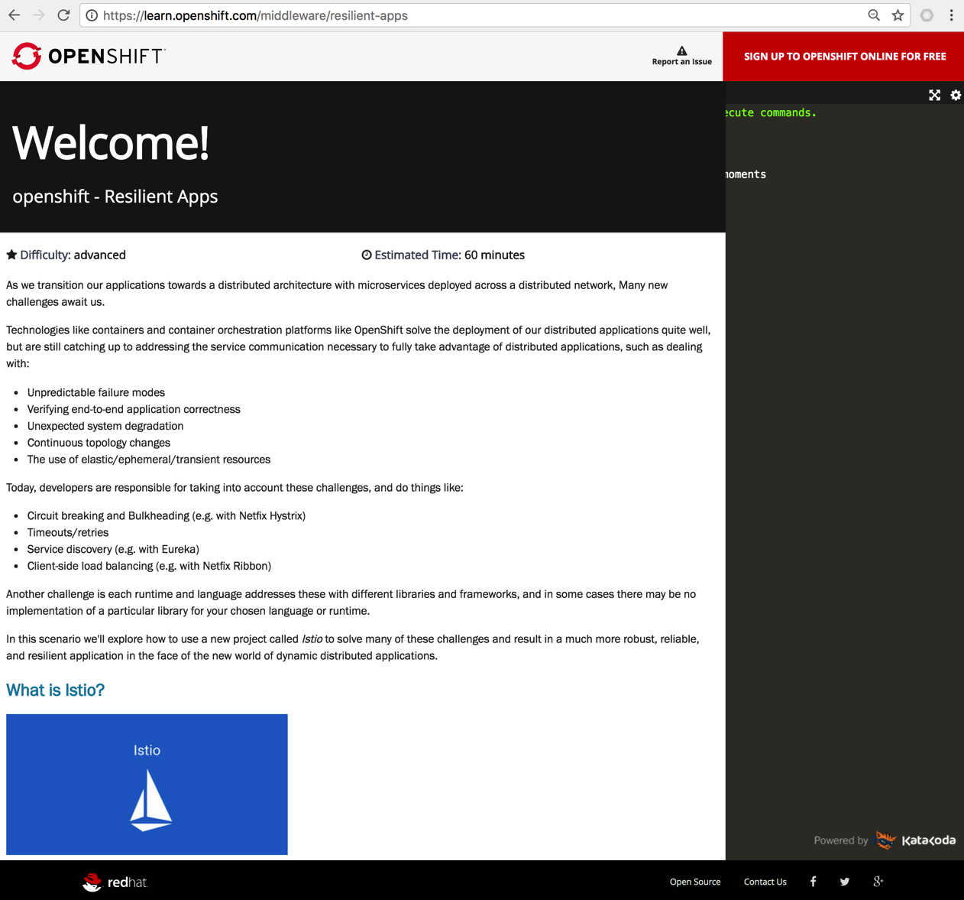
3. Lab 03: Weaving Service Mesh - Istio
https://learn.openshift.com/middleware/resilient-apps

Slide 21


3. Lab 04: Deploying on Service Mesh
Hosting
Edge Proxy
(Load Balancer)
Kubernetes
Node₁
Services
ClusterIP₁
Pod₁
Service Mesh Control Plane
Istio Ingress
Docker₁
ClusterIP₂
Sidecar₁
Istio CA
ClusterIP₃
Istio Pilot
Istio Mixer
Kubernetes
Node₂
Istio Auth
Pod₂
Docker₂

Slide 22
3. Lab 05: Chaining APIs (PoC)
Hosting
Edge Proxy
(Load Balancer)
Kubernetes
Node₁
Services
Pod₁
Pod₂
Docker₁
5
Docker₂
ClusterIP₂
(5001)
(5050)
(test1-svc)
(80)
4
(gis-test-sidecar)
(gis-test-api)
1
ClusterIP₁
(6000)
2
(test1-ambassador- svc)
3
Pod₃
Docker₃
Kubernetes API Server
(gis-validator)

Slide 23
3. Lab 06: Istio – Minimalist Istio Ingress
Hosting
Edge Proxy
(Load Balancer)
Kubernetes
Node₁
Services
ClusterIP₁
Pod₁
Service Mesh Control Plane
Istio Ingress
Docker₁
ClusterIP₂
Sidecar₁
Istio CA
ClusterIP₃
Istio Pilot
Istio Mixer
Kubernetes
Node₂
Istio Auth
Pod₂
Docker₂
To implement this, follow this guide:
https://github.com/kelseyhightower/istio-ingress-tutorial

